Slide 1



When EU v. Irish Law clashes
Business Law
Business Studies - 2020-2021
Yvonne Kelly

Slide 2
What happens when EU v. Irish Law clash?
CASE-STUDY
Irish President Michael D Higgins has signed a Mother and Baby Homes Bill into law after "careful consideration".
The government won a Dáil (Irish Parliament) vote on the controversial bill by 78 votes to 67 in mid-October 2020.
A presidential statement said concerns raised in the discussion of the bill were "serious and must be addressed".
The legislation relates to records gathered by the Mother and Baby Homes Commission.
The Mother and Baby Homes Commission, which is due to issue its final report on Friday, was set up under the 2004 Commission of Investigations Act, which says that records must be kept under wraps for 30 years.
Part of the thinking behind this 2004 Act was to cut costs and allow those giving evidence to a commission to do so without challenge and without legal representation.
The evidence given to the Commission was often in private and in confidence and was simply listened to.
A database of 60,000 records is to be transferred to the child and family agency Tusla, while the remaining records will be sealed for 30 years.
Campaigners on behalf of the mothers and their children have expressed fears they will not be able to access their records if they are sealed.
An online petition generated nearly 200,000 signatures in the days after the Bill was signed into Law by the President.

Slide 3
The 2004 Act v. GDPR
Minister for Children Roderic O’Gorman said in the Dail: “The legal advice received by the Department is that the GDPR right to access personal data (Article 15) is expressly prohibited by section 39 of the Commissions of Investigations Act 2004.”
O’Gorman and the AG asserted that the Government is legally obliged to seal the database complied by the Commission for 30 years under the 2004 Act, which would mean that survivors and families would not have access to their own data for 30 years.
However, the Data Protection Commissioner disagrees with the view put forward by the Department regarding the 2004 Act how GDPR applies to it.
The DPC said that the GDPR law introduced in 2018 “explicitly amended” the 2004 Commissions of Investigation Act so that “any restriction on the right to access personal data processed by the Commission can only be implemented ‘to the extent necessary and proportionate to safeguard the effective operation of commissions and the future cooperation of witnesses’”.

Slide 4
What is GDPR?
General Data Protection REGULATION
The General Data Protection Regulation (GDPR) is the toughest privacy and security law in the world.
Though it was drafted and passed by the European Union (EU), it imposes obligations onto organizations anywhere, so long as they target or collect data related to people in the EU.
The regulation was put into effect on May 25, 2018.
The GDPR will levy harsh fines against those who violate its privacy and security standards, with penalties reaching into the tens of millions of euros.

Slide 5

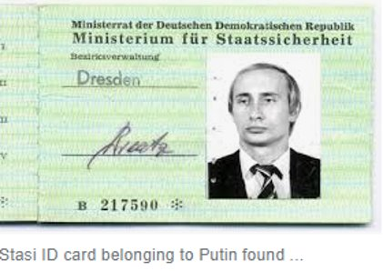
Why? Why is Data Protection important?
European History – World War 2
Eastern Europe because the demise of the Soviet Union.

Slide 6
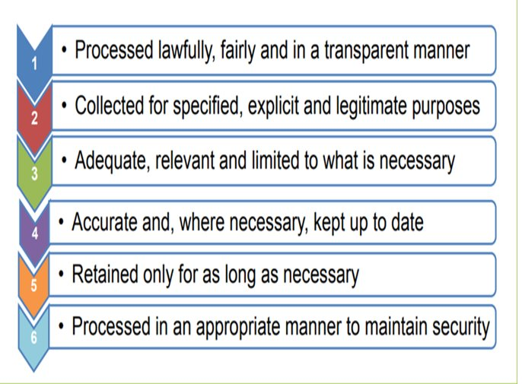
All DATA must be:

Slide 7
EU Law: Directives v.
Regulations
A "regulation" is a binding legislative act. It must be applied in its entirety across the EU. For example, when the EU wanted to make sure that there are common safeguards on goods imported from outside the EU, the Council adopted a regulation.
A "directive" is a legislative act that sets out a goal that all EU countries must achieve. However, it is up to the individual countries to devise their own laws on how to reach these goals. One example is the EU consumer rights directive, which strengthens rights for consumers across the EU, for example by eliminating hidden charges and costs on the internet and extending the period under which consumers can withdraw from a sales contract.

Slide 8
European law has precedence over national laws
If a national rule is contrary to a European provision, be in contained in a Regulation or a Directive, Member States' authorities must apply the European provision.
The European Court of Justice has even ruled that national constitutions should also be subject to the precedence principle.
EU law is superior to national law. This means that Ireland (along with other member states) cannot pass national laws that contradict EU laws. It also means that an EU law can over-rule an Irish law, even if that Irish law was enacted before the EU law came into effect.
Direct effect: As well as being superior to national law, some EU law has direct effect on its citizens. This means that you as a citizen of Europe can rely on EU law in court even in situations where there is no national law in place. Direct effect only applies to EU laws that are binding, clear, precise and unconditional.

Slide 9
What happens if State still refuses survivors access to their personal data?
Individuals can complain to the Data Protection Commissioner
https://www.dataprotection.ie/en/individuals
Individuals can sue government of Ireland in the European Court of Justice
https://ec.europa.eu/info/aid-development-cooperation-fundamental-rights/your-rights-eu_en

